Slide 1

ATM Security & HSM
Security for Automated Teller Machines

Slide 2
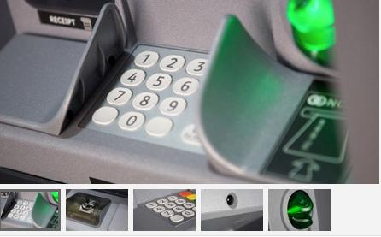
Session’s Outline
ATM Security in today’s world
Basic electronic security concepts and advance requirement
Physical security measures & logical security measures
Introduction to HSM, Security Module & Key Management in E-payment Systems
Nimbus Controller
Nimbus Security Objectives
Host Security Module (HSM)
Overview
Key Generation & Terminal Configuration
Overview of HSM Commands
LAB

Slide 3

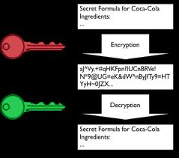
Encryption/Decryption
Encryption is the process of encoding messages (or information) in such a way that eavesdroppers or hackers cannot read it, but that authorized parties can.
Decryption is the process of taking encoded or encrypted text or other data and converting it back into text that you or the computer are able to read and understand.

Slide 4
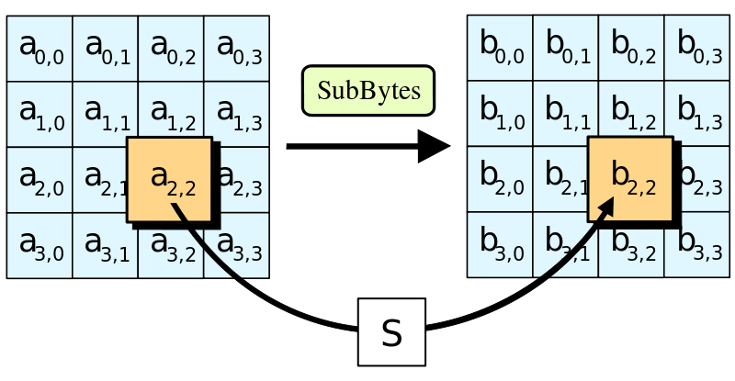
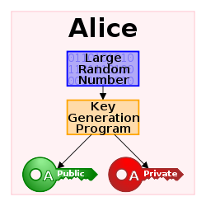
Encryption Schemes
DES
Triple DES
RSA
AES
Twofish
etc

Slide 5
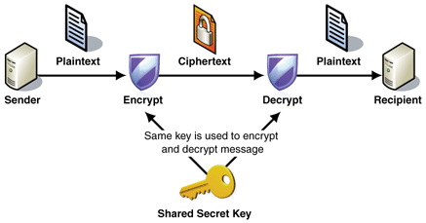
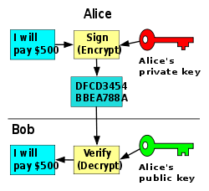
Symmetric vs Asymmetric Encryption
Symmetric Encryption: Use common key for cipher plain text and eventually decipher it.
E.g: DES, 3DES, AES encryption
Asymmetric Encryption: Use two different keys for cipher/decipher text i.e. private key for cipher and public for dechipher text
E.g: RSA encryption

Slide 6

Triple DES
Triple DES, a mode of the DES encryption algorithm that encrypts data three times. Three 64-bit keys are used, instead of one, for an overall key length of 192 bits (the first encryption is encrypted with second key, and the resulting cipher text is again encrypted with a third key).

Slide 7
Encryption Medium
Benefits of Software-Based Encryption
Benefits of Hardware-Based Encryption
Software-based encryption is much simpler to employ. It simply requires the installation of a particular software module onto your computer.
The key for software-based encryption, not being an actual object, is something that cannot simply be lost or misplaced.
Also, it is relatively easy to extend access to various users.
Hardware-based encryption is generally much faster than software-based encryption.
Hardware-based encryption requires no such additional computing strain on the part of the computer.
Furthermore, hardware-based encryption generally has more integrity than software-based encryption, because a hacker usually cannot bypass it without being on location and disassembling the computer itself.

Slide 8

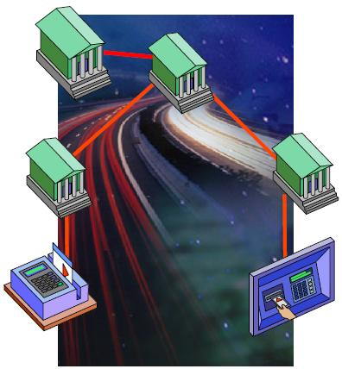
HSM in e-Payment Systems??
ATM transactions exists in Financial Interchange Networks
Proven, ubiquitous end-to-end secure network is required for high volume transaction processing
Banking ATMs use HSM to secure customer PIN and other secure data

Slide 9
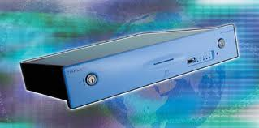

What is HSM?
Host Security Modules (HSMs) is a physical hardware to do all sort of encryption/decryption
Host Security Module Facilities
Key Management
PIN Management
Digital signing
Can be configurable to certain extent

Slide 10
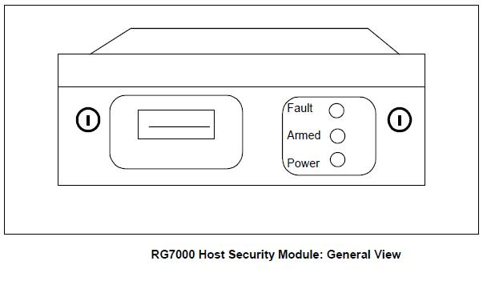
What is HSM? cont..
HSM consists of five units
Front Panel
Rear Panel
Control Unit
Power Unit
Additional Cabinets
Smart Cards are used for HSM login/authorization
HSM processes the command message and generates response against each
Each message contains a variable number of fields

Slide 11
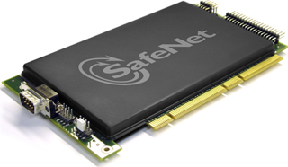
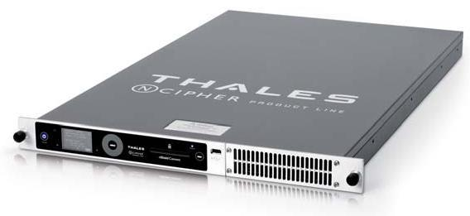
HSM Manufactures
Thales
Model: RG7000, RG8000
SafeNet
Model: Luna EFT, PSG

Slide 12
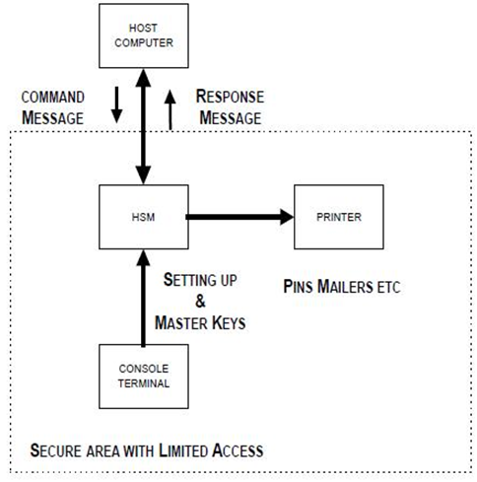
Typical HSM Integration
Host Computer is the Software Application that requires encryption. It can be connected either through Serial Port or Socket, e.g: Thales 7000 have only serial option

Slide 13
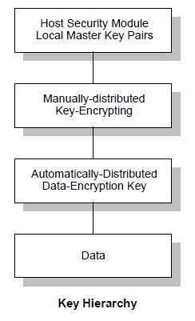
Types of Keys Maintained by HSM
The HSM supports
Master/Session Key (ZMK/TMK)
Transaction Key (ZPK/TPK)
Security for keys is ensured by the use of an enforced key hierarchy and the use of multiple Local Master Key (LMK) pairs.

Slide 14
Types of Keys Maintained by HSM cont..
Data Encrypting Keys (ZPK/TPK): A Zone/Terminal PIN Key is a data encrypting key, which encrypt actual text/data/message, E.g: Customer PIN is usually encrypted with TPK
Key Encrypting Key (ZMK/TMK):
Zone/Terminal Master Key is a
key-encrypting key, which is used
to further secure TPK/ZPKs at the time of its distribution.
Local Master Key (LMK): LMKs are stored in Smart Cards of HSM and all other keys/secret data are encrypted under this key!

Slide 15
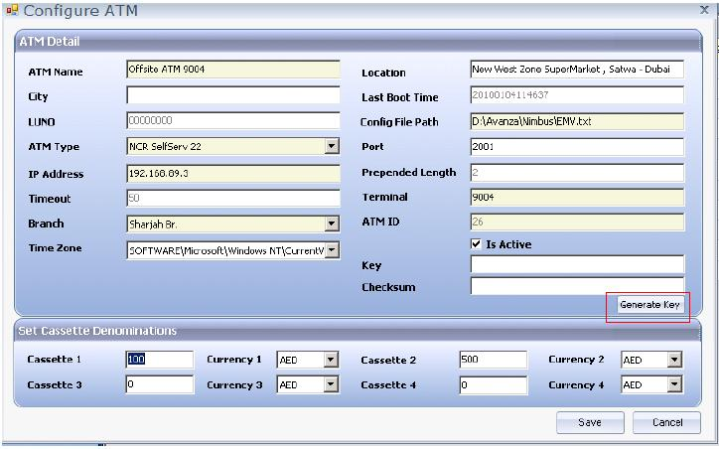
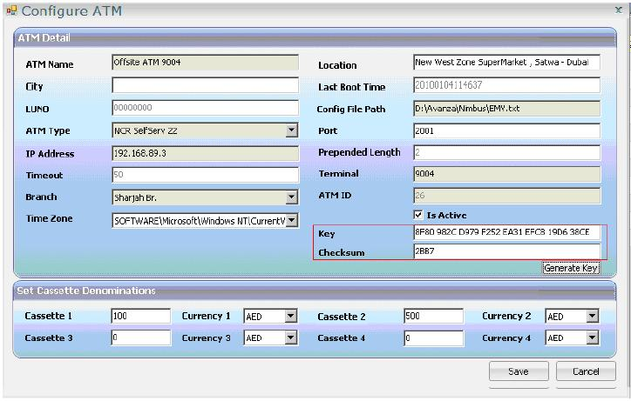
Nimbus Key Generation
Objective is to Generate a clear component of B Key from the HSM.
This can be achieved using the Vision UI. Make sure HSM is in the Authorized Mode for this activity.

Slide 16
Terminal Settings For Nimbus
1. In the supervisory main menu, select the option 6 i.e. ACCESS.
2. A sub menu with more options will appear. Select 25 i.e KEY ENTRY on this sub menu.
3. A menu with four options will appear. Select option 9 i.e. KEY CHANGE ENTRY MODE
4. On this menu, enter the new mode as 3 i.e. DOUBLE LENGTH WITH XOR
5. The terminal will ask for confirmation. Confirm the new mode. After confirmation, the terminal will set the new mode as DOUBLE LENGTH WITH XOR.
6. Now on the KEY ENTRY MENU select option 1 i.e. ENTER KEY B. The ATM will ask which component is to be entered by displaying the following: ENTER COMPONENT (1, 2, 3)
7. Here write 1 and press enter key. Now enter the key which was noted in section 2.1 of this document (B key component 1). Verify that the KVV value displayed by the ATM after key entry is the same as noted in section 2.1 of this document
8. Now follow the step 6 again, but this time enter 2 when ATM prompts for component. Enter 0 for each 32 digits of the component 2.
9. This finishes the settings required on the terminal.

Slide 17
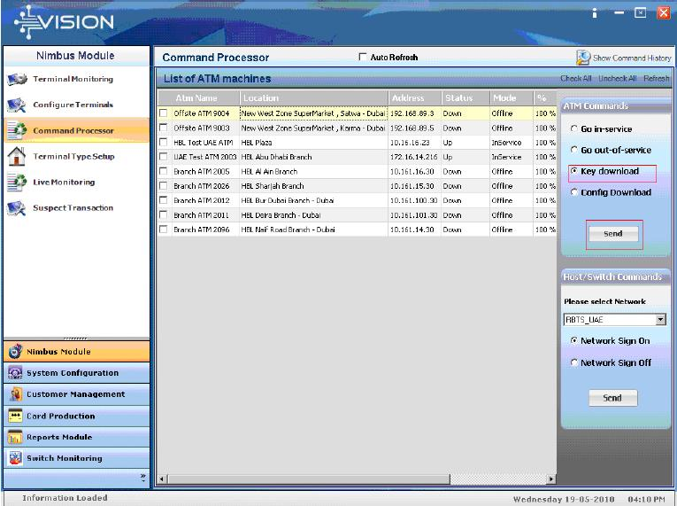
Nimbus Key Change Message
The last step is to send the “Key download” command to the terminal using Vision UI by selecting Key download option and clicking Send Button

Slide 18
Overview of HSM & Commands (Own ATM)
Encrypting a Clear Zone Master Key Component
(“FK” command to Generate three components)
Forming a Zone Master Key From Encrypted Components
(D to join the three components- The output is ZMK)
Generate Key
(KG for ZPK). 001. ZPK

Slide 19
Encrypting a Clear Zone Master Key Component
Online – Auth> FK <Return>
Key Length [1, 2,3]: 2 <Return>
Key Type: 002 <Return>
Key Scheme: U <Return>
Component type [X, H, E, S]: X <Return> (X is for clear XOR)
Enter number of components (1-9): 3<Return>
Enter component 1: U RRRR RRRR RRRR RRRR RRRR RRRR RRRR RRRR (Note that this is the clear TPK from section 2.2 of this document)
After entering this information, the HSM will respond with the following two lines:
Encrypted Key: U TTTT TTTT TTTT TTTT TTTT TTTT TTTT TTTT
Key check value: ZZZZZZ
Note the above encrypted key and the key check value in the two boxes give below:
Encrypted TPK under LMK pair 14-15:
TTTT TTTT TTTT TTTT TTTT TTTT TTTT TTTT
Key Verification value:
KVV: ZZZZZZ

Slide 20
Forming a Zone Master Key From Encrypted Components
Online - AUTH > D < Return >
Input components from smartcards? [Y/N]: N<Return>
Enter number of components (2-9): 2 < Return >
Enter encrypted component 1: XXXXXXXXXXXXXXXX < Return >
Enter encrypted component 2: XXXXXXXXXXXXXXXX < Return >
Encrypted key: YYYY YYYY YYYY YYYY
Key check value: ZZZZ ZZZZ ZZZZ ZZZZ

Slide 21
Generate Key
Online > KG < Return >
Enter key length [1,2,3]: 2 <Return>
Enter key type: 002 <Return>
Enter key scheme (LMK): U<Return>
Enter key scheme (ZMK): X<Return>
Enter ZMK: U XXXX XXXX XXXX XXXX XXXX XXXX XXXX XXXX < Return >
Enter ZMK check value: XXXX XX< Return >
(Enter ZMK variant: X < Return >, if enabled by CS command)
Key under LMK: U YYYY YYYY YYYY YYYY YYYY YYYY YYYY YYYY
Key encrypted for transmission: X YYYY YYYY YYYY YYYY YYYY YYYY YYYY YYYY
Key check value: ZZZZ ZZ

Slide 22
Overview of HSM & Commands (Zone)
Zone can be Country Switch (1Link), Interchange (VISA) etc
Switch Generate
Encrypting a Clear Zone Master Key Component (Z - three components)
Forming a Zone Master Key From Encrypted Components (D command)
Import Key (IK parameter X and U)

Slide 23
Encrypting a Clear Zone Master Key Component
Online - AUTH > Z < Return >
Enter ZMK Component: * * * * * * * * * * * * * * * * < Return >
Encrypted ZMK Component: XXXX XXXX XXXX XXXX
Key check value: XXXX XXXX XXXX XXXX

Slide 24
Forming a Zone Master Key From Encrypted Components
Online - AUTH > D < Return >
Input components from smartcards? [Y/N]: N<Return>
Enter number of components (2-9): 2 < Return >
Enter encrypted component 1: XXXXXXXXXXXXXXXX < Return >
Enter encrypted component 2: XXXXXXXXXXXXXXXX < Return >
Encrypted key: YYYY YYYY YYYY YYYY
Key check value: ZZZZ ZZZZ ZZZZ ZZZZ

Slide 25
Import Key
Online - AUTH > KI < Return >
Key type: 002 < Return >
Key Scheme: U<Return>
Enter ZMK: aaaa aaaa aaaa aaaa bbbb bbbb bbbb bbbb < Return >
(Enter ZMK variant: X < Return >, if enabled by CS command)
Enter key : X XXXX XXXX XXXX XXXX XXXX XXXX XXXX XXXX < Return >
Key under LMK: U MMMM MMMM MMMM MMMM MMMM MMMM MMMM MMMM
Key Check Value: NNNN NN

Slide 26
HSM Commands
(LAB using Thales Simulation Program)

Slide 27

Questions & Answers

